Slide 1

FRAUDELENT TRANSACTION PREDICTION
Group 2
Domain:Banking Domain
Mentor:
Ritesh Maury
Team Member:
1}Deepak shimpi
2}Aishwarya Dharmadhikari

Slide 2
Business Problem
In US Financial company which has a revenue of $10 billion.
it is losing about 2% of it’s revenue,i.e $20 million,due to fraudulent transaction
Objective:
Develop a model for predicting fraudulent transactions for a financial company to minimize fraud cases.

Slide 3
Project Architecture / Project Flow
Project Flow can be defined by the following steps
Exploratory Data Analysis
Data Visualization
Data Preprocessing
Outlier Treatment
Feature Selection
Balancing the im-balanced data
Model building
Comparison of Performance
Deployment

Slide 4
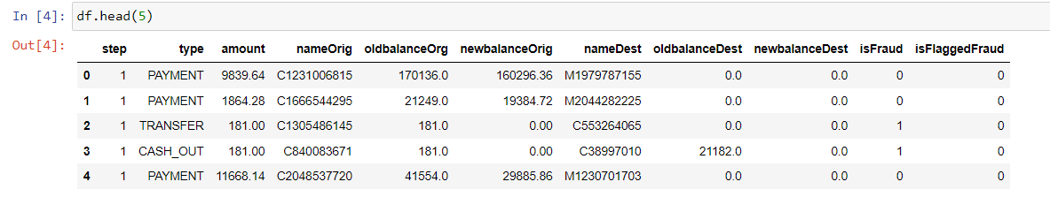
EDA:
Understanding the data:
-data contains no missing value
-contains 6362620 rows and 11 columns
-contains no duplicate

Slide 5
Data Dictionary:
step - maps a unit of time in the real world. In this case 1 step is 1 hour of time. Total steps 744 (30 days simulation).
type - CASH-IN, CASH-OUT, DEBIT, PAYMENT and TRANSFER.
amount - amount of the transaction in local currency.
nameOrig - customer who started the transaction
oldbalanceOrg - initial balance before the transaction
newbalanceOrig - new balance after the transaction
nameDest - customer who is the recipient of the transaction
oldbalanceDest - initial balance recipient before the transaction. Note that there is not information for customers that start with M (Merchants).
newbalanceDest - new balance recipient after the transaction. Note that there is not information for customers that start with M (Merchants).
isFraud - This is the transactions made by the fraudulent agents inside the simulation. In this specific dataset the fraudulent behavior of the agents aims to profit by taking control or customers accounts and try to empty the funds by transferring to another account and then cashing out of the system.
isFlaggedFraud - The business model aims to control massive transfers from one account to another and flags illegal attempts. An illegal attempt in this dataset is an attempt to transfer more than 200.000 in a single transaction.

Slide 6
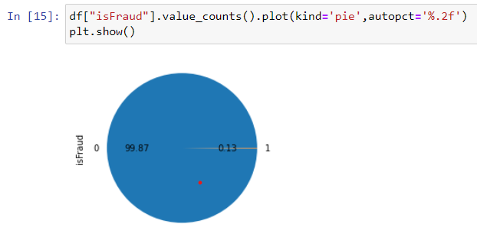
Completely imbalanced data
we have an imbalanced dataset in which 99.87% of transactions are normal.
Only about 0.13% of transactions are fraudulent.

Slide 7
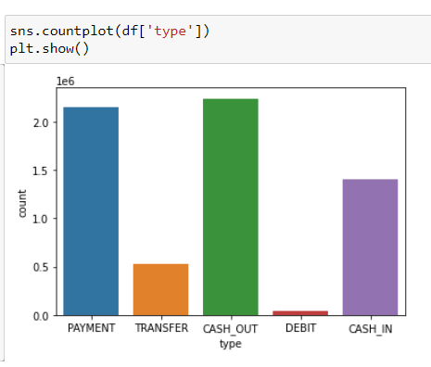
From Below observations it seem most of Fradulent tranctions
was from TRANSFERS and CASH_OUT

Slide 8
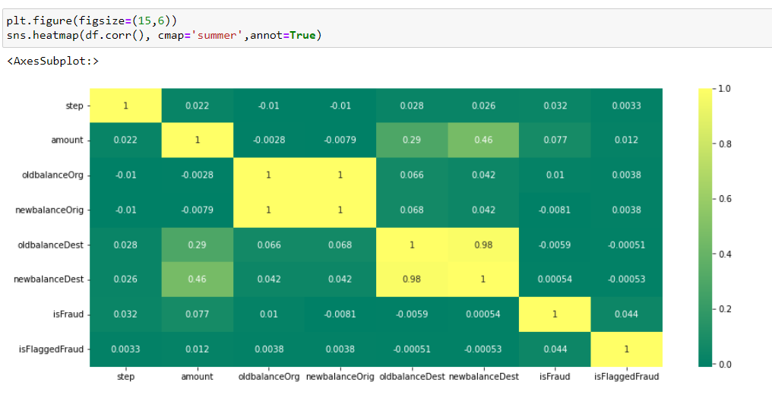

Slide 9
Balanced the data:
so we should mark all the transactions where the newbalance becomes zero after cashout or transfer it is the possible fraud
Newbalance change in Destination is zero whether the transaction is transfer or cashout it is the fraud transaction
oldbalanceOrg in which balanced is zero whether the transaction is transfer or cashout it is the fraud transaction

Slide 10
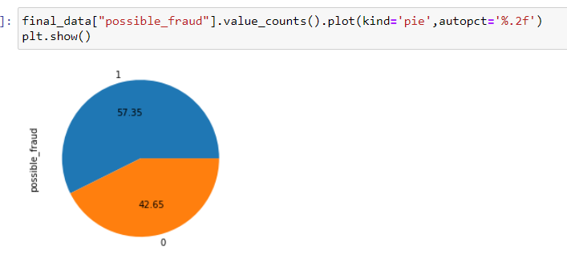
After Balancing the data

Slide 11
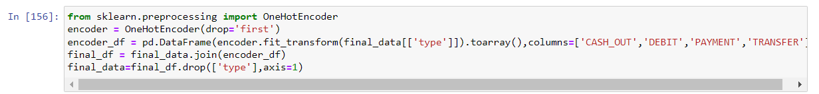
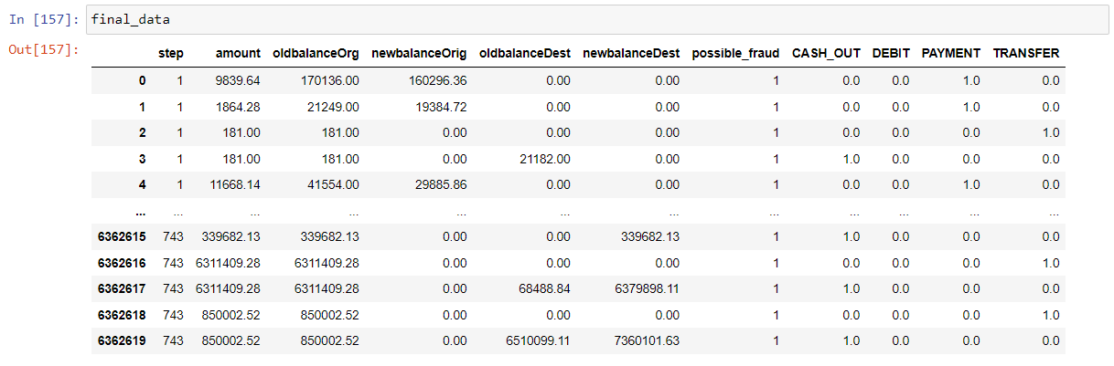
Data preprocessing:

Slide 12

Model Building:
1]Logistic Regression
2]Xg-Boost
3]Light-GBM

Slide 13
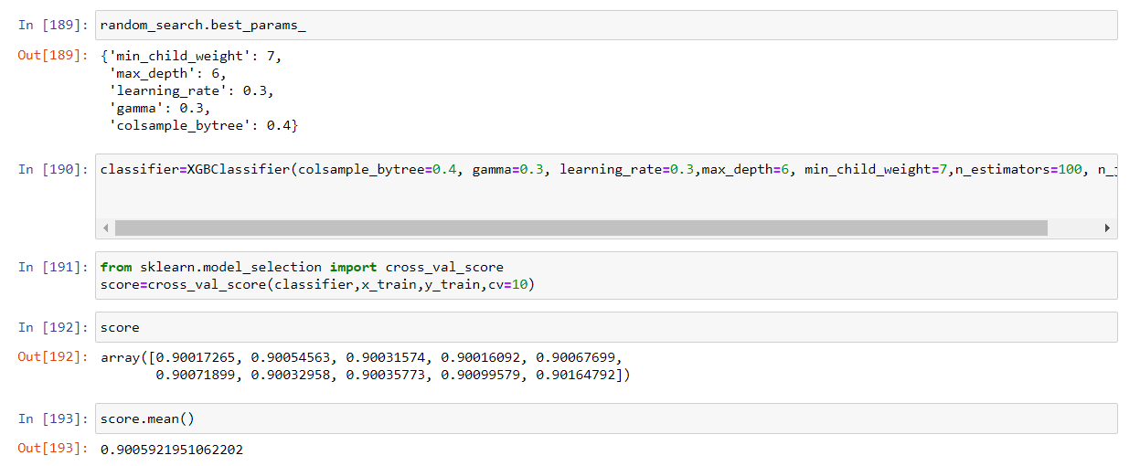
Select model and hyperparameter-tunning
Xg-Boost is giving the best accuracy and tune the
Hyperparameter it’s accuracy increase upto 90%

Slide 14
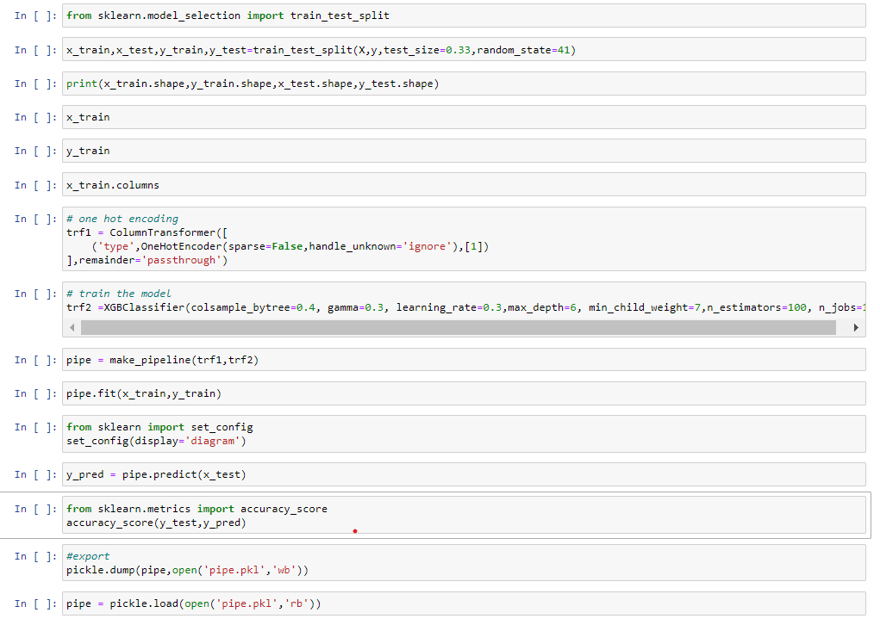
Model code pipeline

Slide 15
Model Deployment using Streamlit

Slide 16
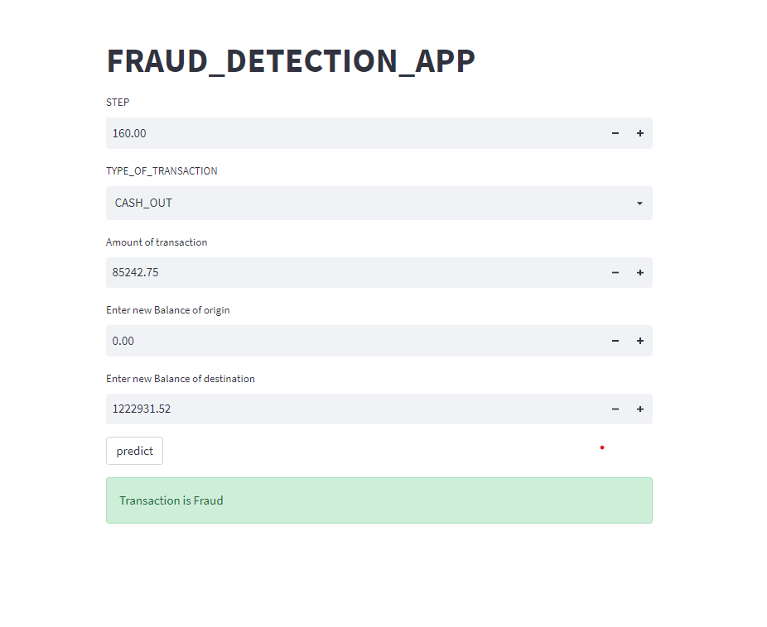

Slide 17
Challenges faced?
Data was completely imbalanced.
Target column has to be made manual by putting some codition.
Dataset was also consisting of outliers.
Finding the Best Model

Slide 18
Github Link
https://github.com/deepakshimpi001/streamlit_fraud_app/blob/14187efa005ad776317b02b98eb6ce56565733d1/Fraud%20Detection%20Project-13-07-2022.ipynb

Slide 19
Thank You

